Slide 1
The Talloires Network Evolution & Strategic Direction

Slide 2
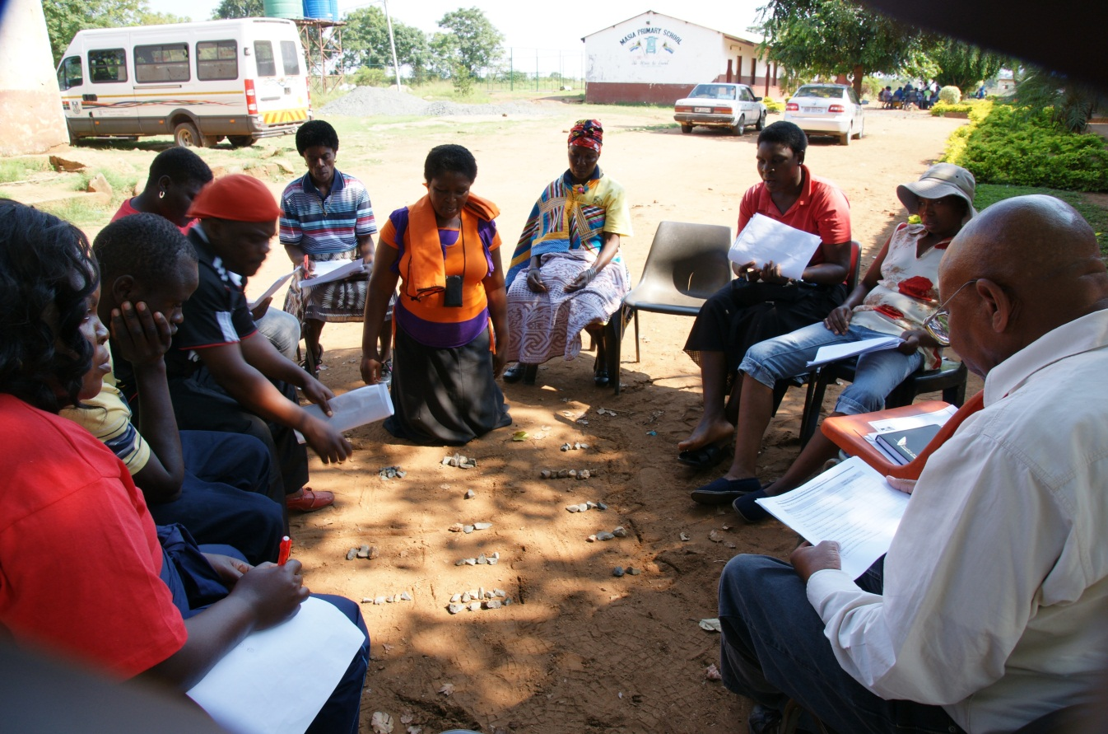
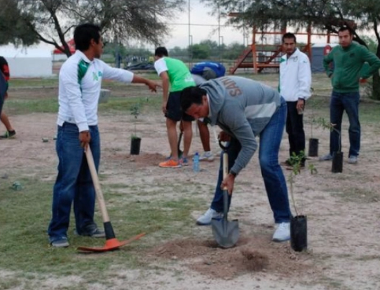
Mission
The Talloires Network is an independent international association of institutions committed to strengthening the civic roles and social responsibilities of higher education.
Vision
The Network envisions universities around the world as dynamic forces in their societies, incorporating civic engagement into their research and teaching. We believe that universities have a responsibility to develop the next generation of active citizens who will address community challenges around the world.

Slide 3
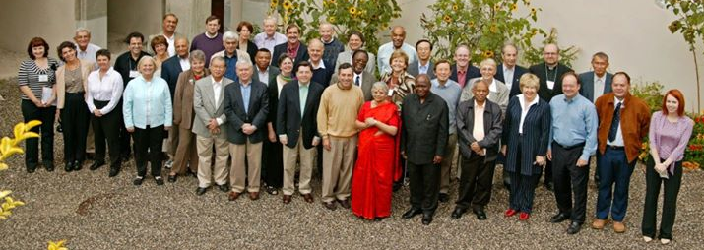
History
Founded in 2005 by 29 university leaders from 23 countries at the Tufts European Center in Talloires France
Founding Executive Director, Rob Hollister, Dean of Tisch College
Produced the Talloires Declaration on the Civic Roles and Social Responsibilities of Higher Education
Today there are 380 signatory members in 77 countries

Slide 4
2005 Founding and signing of the Talloires Declaration
2005-2011 Lawrence S. Bacow serves as Steering Committee Chair
2010 Santander Universities grant, $750K over 3 years
2011 Global conference in Madrid, Spain
2011-2014 Mark Gearan serves as Steering Committee Chair
2013 Santander Universities renewed support for $750K over 3 years
2013 Mastercard Foundation grant begins
2014 Anthony P. Monaco begins service as Steering Committee Chair
2014 Global conference in Cape Town, South Africa
2016 Santander Universities grant of $200K for 1 year
2017 Global conference in Veracruz, Mexico
2017 Mastercard Foundation grant draws to a close
2017 Santander Universities final grant of $100K for 1 year
2017 Talloires Network institutes dues policy in order to achieve sustainability
Chronology

Slide 5
Governance
Governed by an elected Steering Committee serving 3-year terms
10 heads of universities, 3 heads of national or regional networks, and 2 student representatives (representing 12 countries on 6 continents)
Chaired by Anthony P. Monaco, President of Tufts University
Cheryl de la Rey, University of Pretoria, South Africa, Vice Chair
Haifa Jamal Al-Lail, Effat University, Saudi Arabia
Nisar Ahmed Siddiqui, Sukkur IBA University, Pakistan
Mabel O. Imbuga, Jomo Kenyatta University, Kenya
Sara Ladrón de Guevara, Universidad Veracruzana, Mexico
Lorraine McIlrath, National University of Ireland, Galway, Ireland
Santa Ono, University of British Columbia, Canada
Andrew Petter, Simon Fraser University, Canada
Maria Nieves Tapia, Latin American Center for Service-Learning, Argentina
Rajesh Tandon, Society for Participatory Research in Asia, India
Andrew Vann, Charles Sturt University, Australia
Adam Weinberg, Denison University, USA
Abigail Gómez, Universidad Veracruzana, Mexico (student)
Mapendo Mindje, University of Rwanda, Rwanda (student)

Slide 6
Administration
The Talloires Network is administered by a secretariat, which is based at the Jonathan M. Tisch College of Civic Life
The Talloires Network and Tisch College share the belief that universities have a responsibility to develop the next generation of active citizens who will address the tremendous challenges facing our communities, our nations and the world
Dean
Tisch College
SC Chair
Tufts President
Elected Steering
Committee
Executive Dir.
Secretariat
Membership

Slide 7
Platform: Action Research
The Network contributes to the global university civic engagement movement by way of inquiry and action
The Network advocates integration of Research, Education and Practice within institutions of higher education
The Network recognizes the historical dominance of the Global North and facilitates South-North dialogue and exchange
Research
Education
Practice
Talloires Network

Slide 8
Guiding Values for Higher Education:
Access, Leadership, and Livelihoods
The Network focuses its research, education, and practice on three interrelated human rights and corresponding responsibilities:
1) The right to education; the responsibility of higher education to be socially inclusive and to promote quality education for all, including people from disenfranchised and indigenous communities
2) The right to leadership opportunities and economic mobility; the responsibility of higher education to create prosperous communities and societies
3) The right to a livelihood; the responsibility of higher education to prepare people for employment and entrepreneurship, and to contribute to local development

Slide 9
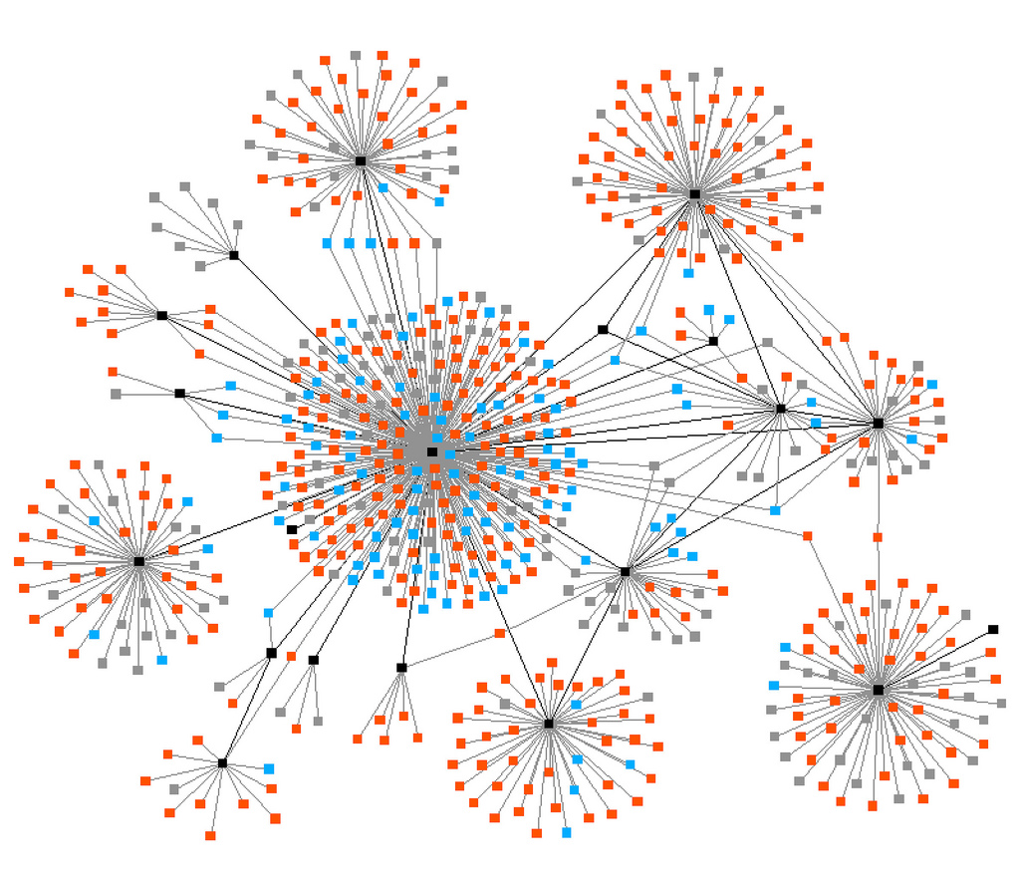
Key Assets
Geographic breadth and diversity of membership
Influence as a “network of university networks”
Successful programs and activities
Leadership from engaged members
Partnerships with foundations
Research publications (in the field)
Repository of global data on university civic engagement programs
SC members’ stature and leadership
Reach of newsletter and social media
Europe
Pakistan
TN
Arab Region
Australia
Asia
South Africa
Latin America

Slide 10
Successful Programs and Activities
University entrepreneurship education programs
International prize for global citizenship
International student exchange programs
Faculty development programs
Writing and research collaborations
Graduate research seminars
International workshops, webinars, and conferences
Sharing best practices
Creation of national and regional networks

Slide 11
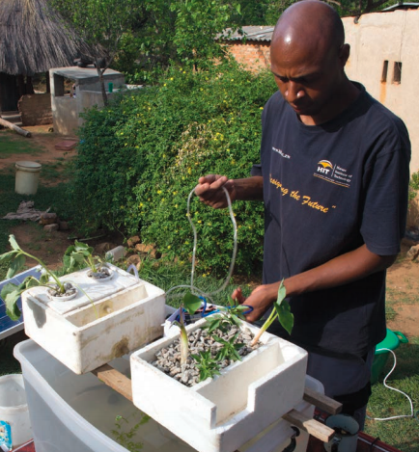
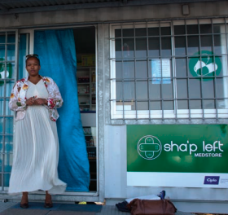
Research Platform: Youth Economic Participation Initiative (YEPI)
214 group businesses created
1,932 participants transitioned into a job
678 graduates are self-employed
18 patents developed
$5.9 million
8 grants
14 countries
3.5 years

Slide 12
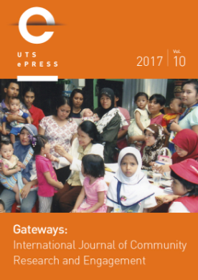
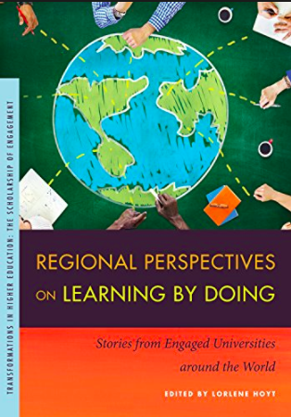
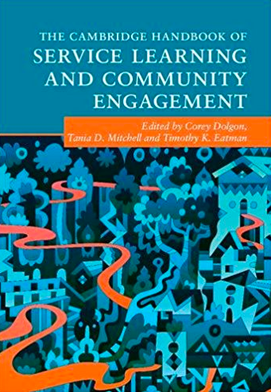
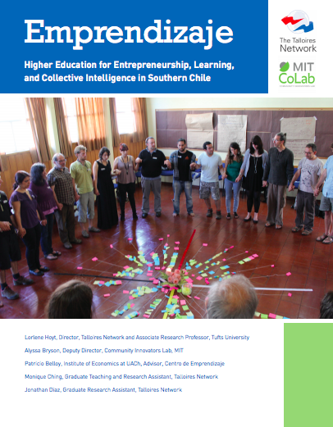
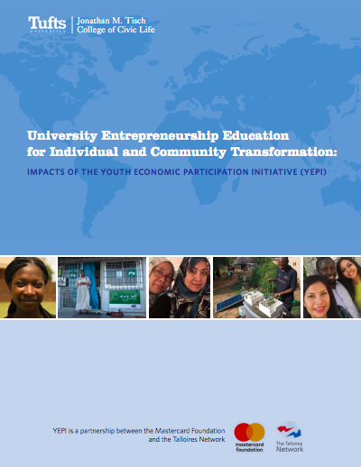
Research Publications
Notes:
Ladron de Guevara, S. and A. Monaco. 2017. “Study at home, not abroad: the universities building local relationships.” London: Times Higher Education. June 20. https://www.timeshighereducation.com/blog/study-home-not-abroad-universities-building-local-relationships
Monaco, A., and C. de la Rey. 2015. “World University Rankings blog: should global league tables consider community engagement?” London: Times Higher Education. September 5. Accessed August 1, 2016, https://www.timeshighereducation.com/blog/world-university-rankings-blog-should-global-league-tables-consider-community-engagement.
Vuong, T., Newcomb Rowe, A., Hoyt, L., and C. Carrier. 2017. “Faculty Perspectives on Rewards and Incentives for Community-Engaged Work: A Multi-national Exploratory Study.” Gateways: International Journal of Community Research. http://epress.lib.uts.edu.au/journals/index.php/ijcre/issue/view/413

Slide 13
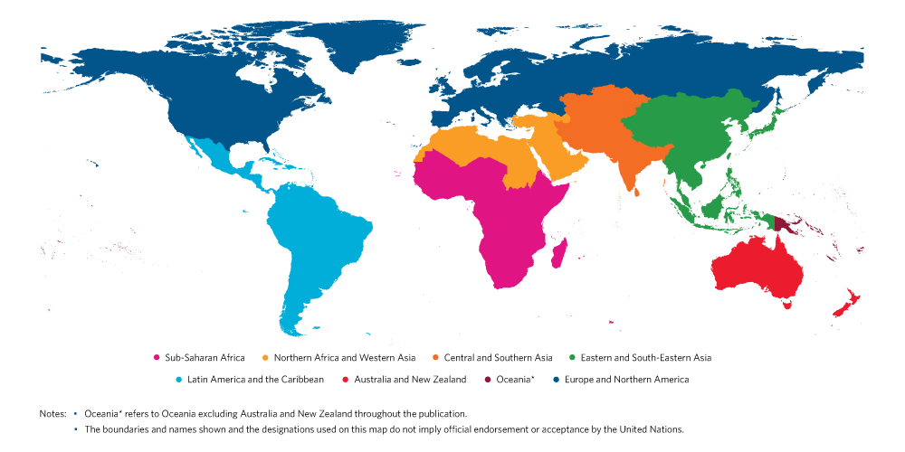
Geographic Breadth and Diversity of Membership
380 Signatory Members in 77 Countries
62
76
86
20
9
59
41
17

Slide 14
Types of Membership
Signatory Membership signals an institutional commitment to the ideals of university civic engagement and social responsibility to address pressing problems Requires a letter of commitment to the Talloires Declaration signed by the university president, vice-chancellor, or rector
Engaged Membership is a commitment to supporting TN operations, programs, and research by contributing annual dues based on the host country’s Human Development Index rating, according to the United Nations Development Program Requires Signatory Membership plus annual dues payment

Slide 15
Benefits of Membership
Signatory Membership
Use of Network’s logo
Access to the Network’s newsletter, social media platforms, and publications
Attend Network global conferences, share best practices
Nominate individuals to serve on Steering Committee, vote in SC elections
Engaged Membership
Nominate programs for the annual MacJannet Prize for Global Citizenship
Apply for institutional, faculty/staff, and student grant programs
Receive fee waiver for the Carnegie Community Engagement International Classification
Participate in collaborative writing and research projects
Access to global data repository on university civic engagement programs
Disseminate best practices via Network’s newsletter and social media platforms
Lead plenary sessions at the Talloires Network Global Leaders Conference
Serve on the Talloires Network Steering Committee
Enjoy all benefits of Signatory Membership

Slide 16
Financial Support from Engaged Members
38 Engaged Members in 23 countries
Tiered membership dues structure
Change in business model to ensure sustainability
Tier 1
$7,500
Tier 3
$2,500
Tier 4
$500
Tier 2
$5,000
Engaged Membership Tiers

Slide 17
Partnerships with Supporters and Foundations
Current:
MacJannet Foundation
Kettering Foundation
Santander Universities
Engaged Members
Tufts University and Tisch College
Recent:
Mastercard Foundation
Pearson Foundation
Rockefeller Foundation
Walmart Foundation
New Eurasia Foundation
Ishyama Foundation
Carnegie Corporation of New York
Active discussions underway with these and other potential sponsors about future collaborations

Slide 18
Strategic Priorities
Expand research platform with new collaborations
International Carnegie Community Engagement Classification
Rebranding – new name and logo
TNLC 2020 – next Talloires Network Leaders Conference
Spain, 2011
South Africa, 2014
Mexico, 2017

Slide 19
Strategic Direction: An Inflection Point
New and renewed leadership on the Steering Committee
New Executive Director
New financial model of shared ownership in the Network
New relationships, ideas, and momentum from the successful conference in Xalapa, Mexico
New and major publications, contributing to knowledge in the field
New opportunities for collaboration with supporters
New trends in higher education that align with Network mission and vision
New home at Tisch College

Slide 20
Thank You
TalloiresNet
The Talloires Network
Http://talloiresnetwork.tufts.edu

